Slide 1


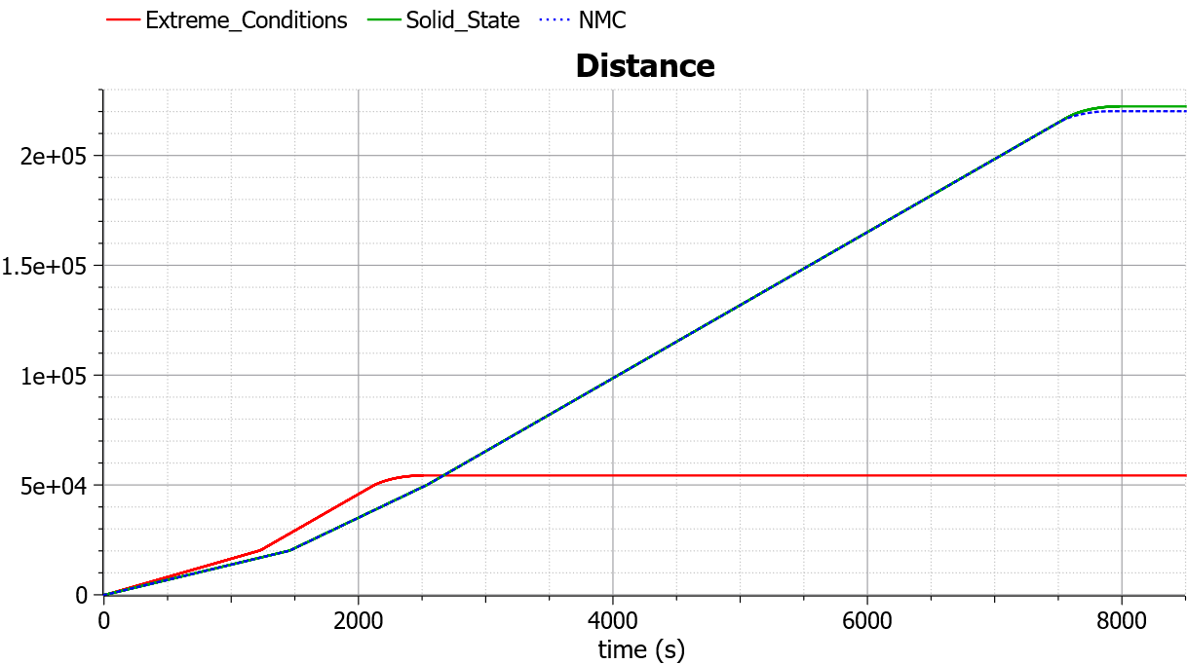
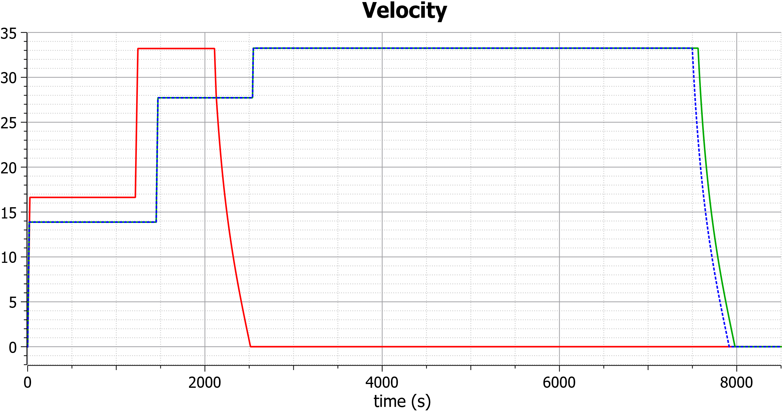
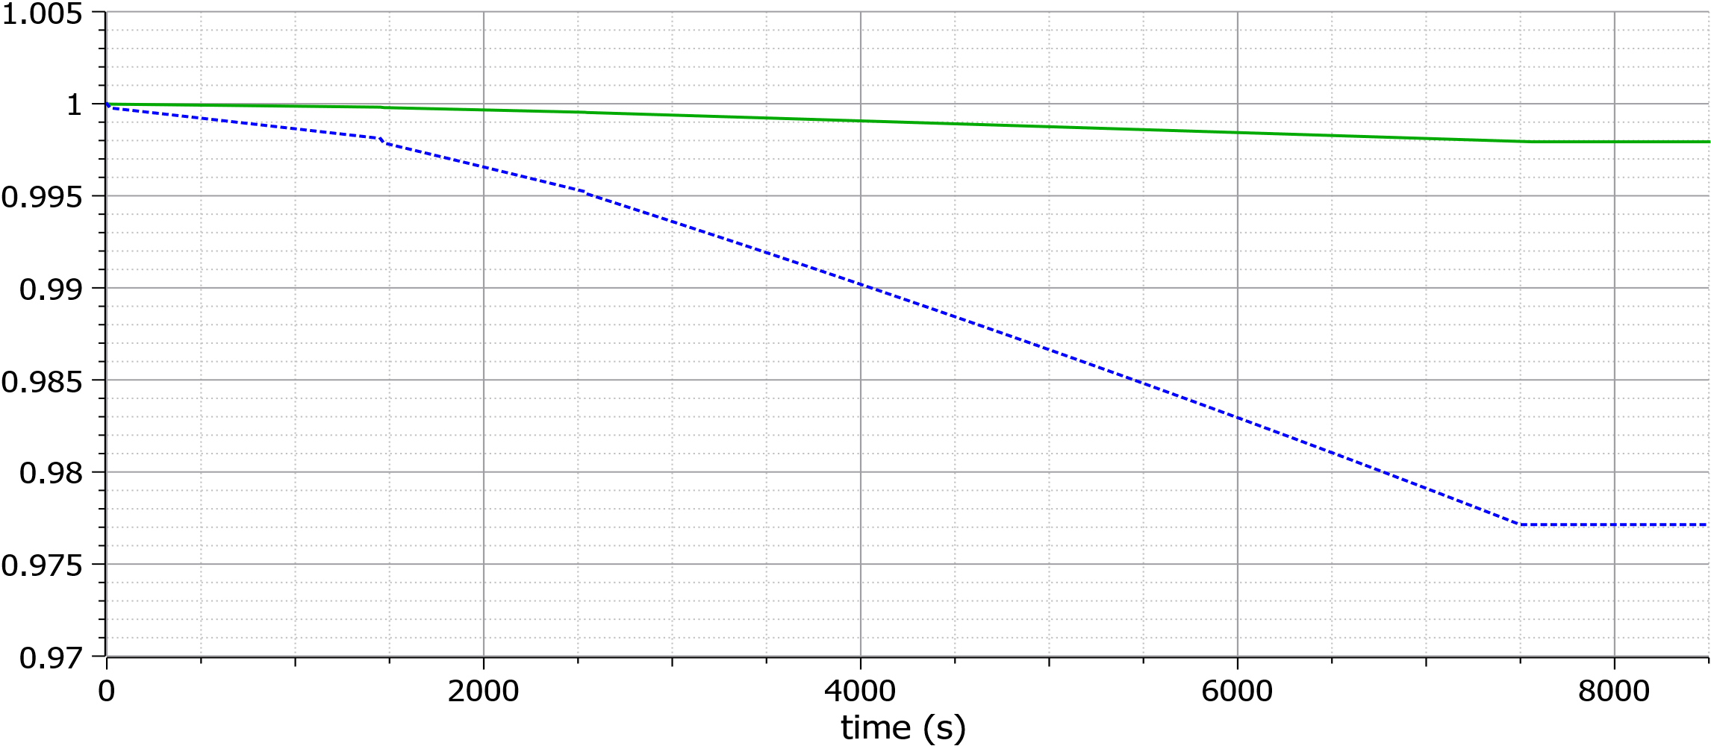

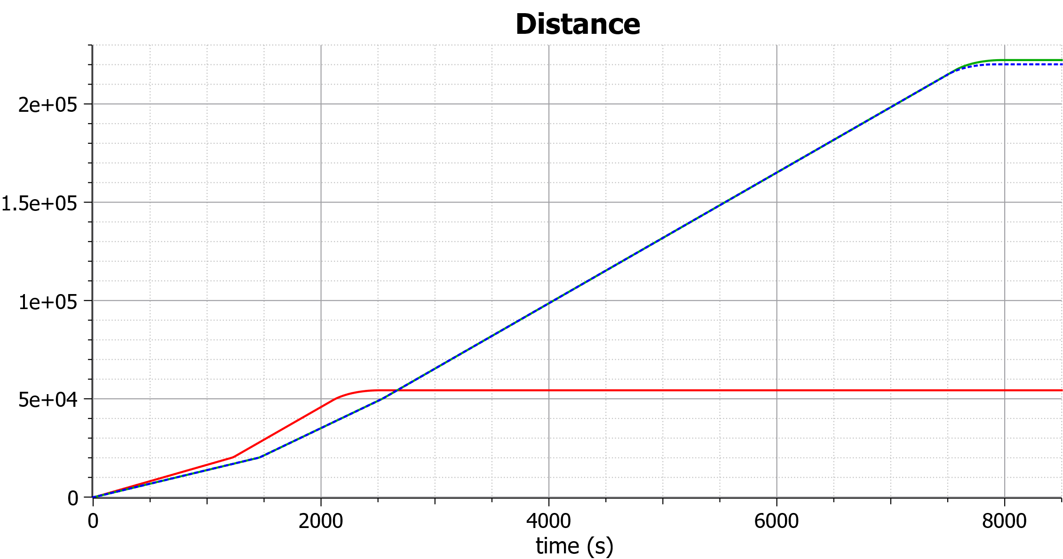
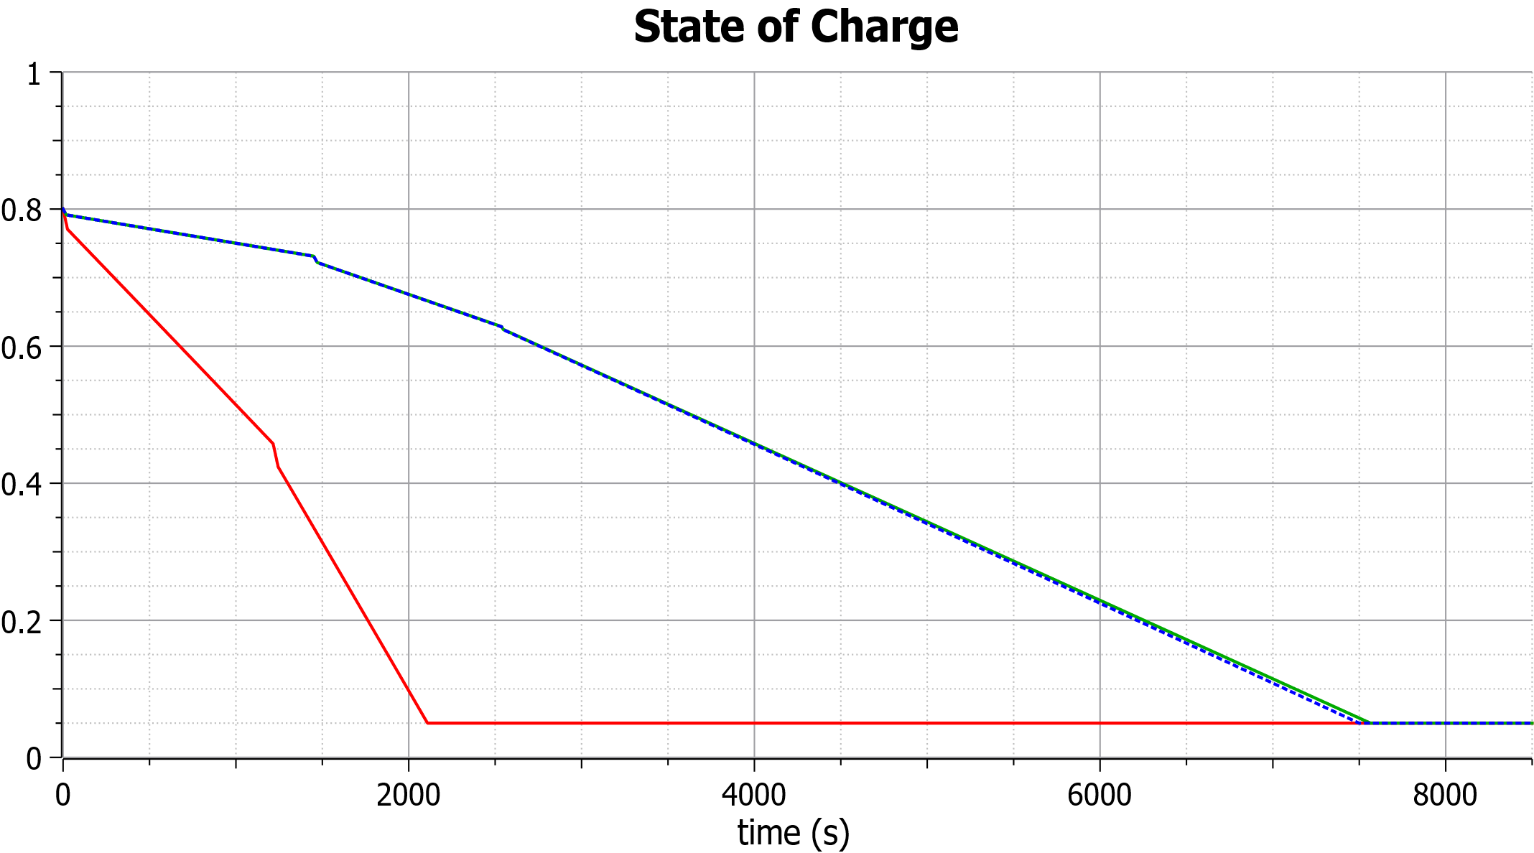
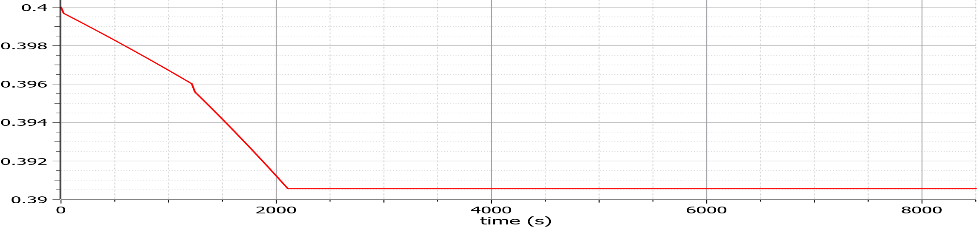
EV Range Simulation
Enabling Efficient EV Battery Development Through Digital Twin Simulation
Authors: Lack Laurin, Ždralović Džejlan, Redecker Silke
Goal | Background | Use Case | Limitations
Simulate the range of an electric vehicle (EV) with various battery models and additional external factors. | Rapid EV adoption driven by sustainable transportation needs. | Developing new battery concepts is costly and time-intensive. Simulation enables evaluation without physical prototypes. Our library provides physics-based range estimation for new concepts. | Simplified Environment, Lossless motor model, No energy recuperation (regenerative braking)
Model Simulation and Results
Solid-state battery achieves the longest range, while extreme conditions significantly reduce driving distance. | Baseline scenarios maintain the target driving profile, whereas extreme conditions cause early termination.
Extreme conditions lead to rapid SOC depletion, while solid-state batteries show smoother discharge. | Battery degradation remains low under nominal conditions but accelerates in extreme operating scenarios.
References
[1] J. Larminie and J. Lowry, Electric Vehicle Technology Explained, 2nd ed., Wiley, 2012. Available online: Electric_Vehicle_Technology_Explained.pdf.
[2] R. C. Kroeze and P. T. Krein, “Electrical battery model for use in dynamic electric vehicle simulations,” Dept. of Electrical and Computer Engineering, University of Illinois at Urbana-Champaign, Urbana, IL, USA.
Outlook
More complex environment
Multiple charging cycle simulation
Advanced motor & vehicle models

